Slide 1
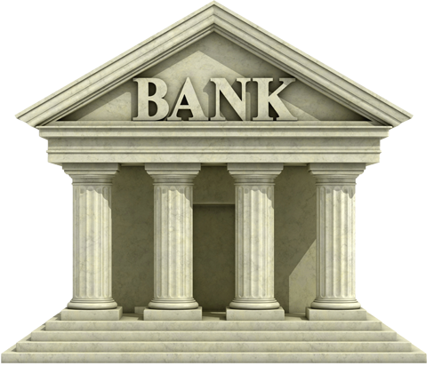
Bank Accounts
Money Matters Topic 1

Slide 2
Checking Accounts
Used as working accounts. Money comes in by deposits. These can be cash, check (done at bank), or even direct deposits (set-up through your employer). Some banks now offer check cashing apps.
Money leaves by writing checks, using a linked debit card, or automated transfer. These are called withdrawals.
Considerations-Close to home, no fees. Should be federally insured. Often called FDIC insured (Federal Deposit Insurance Corporation). Recommendations usually suggest 1-2 months o f living expenses.

Slide 3
Transaction Registers
These are used to keep track of how much money you have in your checking and/or savings account. They will be as accurate as you keep them. Many online banking services can be used to check the balances.

Slide 4
Transaction Register Practice
Example-Open a bank account with $500.
Direct deposit from paycheck of $678.90 on October 1st
PPL automatic withdrawal of $106.57 on October 10
Debit of $100 on October 12
Check number 1500 for $180.63 on October 15.
What is the balance on October 16?

Slide 5
Savings Accounts
These are used to hold spare money or back-up funds. They can be short term or mid-range. Long range savings accounts are really retirement accounts. Some can be linked to checking accounts or have automatic deposits and withdrawals. Short term Usually earn a small amount of interest. Mid range usually earn moderate interest.
Considerations- some need activity to remain open. Should be federally insured. Recommendations usually include 3-6 months living expenses in all savings accounts combined. We will explore types in presentation 3.

Slide 6
Where to open checking or savings accounts
Banks or Credit Unions-No fee options recommended. Credit Unions are similar in function to banks, but operate as non-profit institutions. So they usually are a bit cheaper with fees because they have fewer buildings, management fees, and lower operating costs.

